Slide 1

Government polytechnic for women kadapa Approved by AICTE, New Delhi &Affiliated to SBTET AP
Half yearly Magzine
COMPUTECHIE
July-December 2022
Department of
Computer Engineering
Volume - 1 issue- 1

Slide 2

Department vision
Develop computer engineers to be technologically adept, innovative, self-motivated, responsible citizen with human values, high quality skill and to contribute significantly towards ever changing computer technologies.
Department mission
M1: To provide opportunity to Diploma students who are capable of playing pivotal role in wide aspects of modern computer engineering.
M2: To make the students understand basic concepts underlie in computer engineering and able to apply them creatively in different fields of engineering.
M3: To train the students sensitive to the environment ,safety and economic context.
M4: To produce technically skilled students through intensive training in computer engineering tools and applications and to prepare the for professional career and further research.
GOVERNMENT POLYTECHNIC FOR WOMEN, KADAPA

Slide 3
ABOUT DEPARTMENT
The Department of Computer Engineering was established in the year 2008, offering “Diploma in Computer Engg” with intake 50, affiliated to SBTET, AP, Mangalagiri. The Diploma in Computer Engg Programme has a comprehensive curriculum on topics related to all aspects of Computer Hardware and Software with an emphasis on practical learning. The course structure is up-to-date and includes courses on nascent topics to equip our students with the latest developments in Computer Science and Engineering.
It has consistently fulfilled its role of producing Computer Engineers ready to meet the demands of the IT world. The department has always attracted the best of engineering girl aspirants from all over the Rayalaseema Region of Andhra Pradesh.
GOVERNMENT POLYTECHNIC FOR WOMEN, KADAPA

Slide 4
PROGRAM EDUCATIONAL OUTCOMES(peos)
PEO1
To produce best diploma students as computer engineering technicians by correlating growing need of the industries in modern topics with the academic input and giving the technical knowledge for further learning and to provide better career in this field.
PEO2
To prepare the students as productive computer engineer s , possessing , supportive and leadership skills in multi disciplinary domain expertise in practical orientation , communication skills and latest developments.
PEO3
To give the depth of related skills and expertise in a single field and the ability to collaborate with other disciplines and work at the supervisory cadre.
GOVERNMENT POLYTECHNIC FOR WOMEN, KADAPA

Slide 5
PEO4
To promote the students in professionalism, by successful completion of the Diploma in Computer Engineering by empasizing field practice in industry oriented activities.
PEO5
To sensitize the students on social and economic commitment and to inculcate a nature to gaurd the values of community and protect environment
GOVERNMENT POLYTECHNIC FOR WOMEN, KADAPA

Slide 6
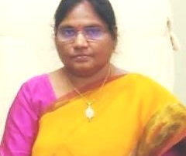
MESSAGE
PRINCIPAL’s MESSAGE
Smt . C.H.JYOTHI,
M .Tech
It gives me immense pleasure to pen a few words as prologue to the half yearly technical magazine COMPUTECHIE exclusively meant for churning out the latent writing talent which bears immense potentially of sharpening the students skills as part of their overall personality development .I congratulate all the contributors for bringing out such a beautiful magazine.
GOVERNMENT POLYTECHNIC FOR WOMEN, KADAPA

Slide 7
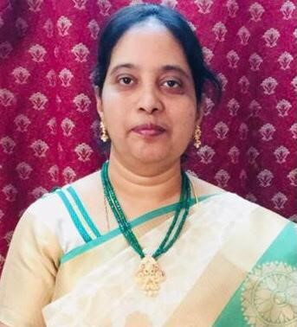
HOD’S MESSAGE
Smt. K. SUDHARANI M.tech
It is a occasion of great pride and satisfaction for the department of CME, GPW to bring out the issue of the half yearly of the Technical magazine COMPUTECHIE. It gives me immense pleasure to note that the response to the magazine has been overwhelming .The wide spectrum of articles gives us a sense of pride that our students and faculty possess creative potential and original thinking in ample measures. Each article is entertaining interesting and absorbing .I applaud the contributors for their stimulated thoughts and varied hues in articles contributed by them.
GOVERNMENT POLYTECHNIC FOR WOMEN, KADAPA

Slide 8
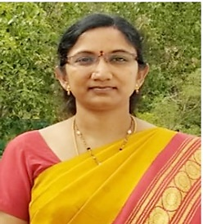

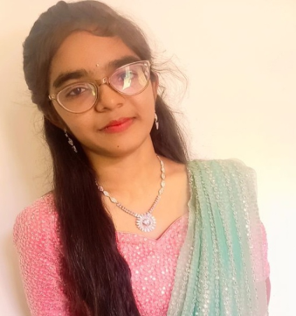
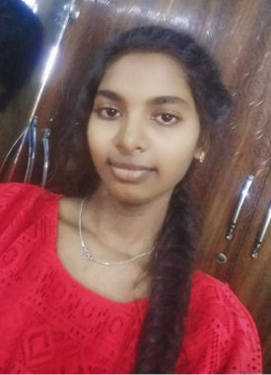
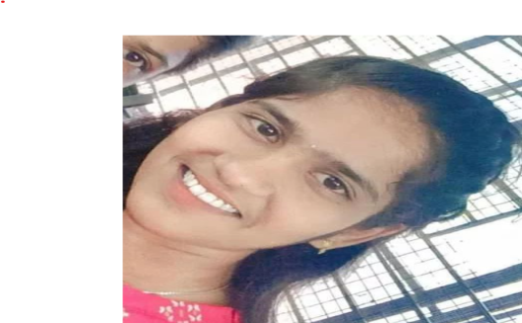
EDITORIAL TEAM
Faculty
Smt. U. Rajya Lakshmi , SL/CME
Dr.V . Hari Prasad L/CME
STUDENTS
K. V. Sushma Reddy, DCME,II year
K. Sunanda ,DCME,II year
K. Bhuvana Manasa ,DCME ,II year

Slide 9

FACULTY ARTICLES
BLOCKCHAIN TECHNOLOGY
Blockchain is a decentralized and distributed digital ledger technology that records transactions across different computers or nodes. In a blockchain, each record of a transaction, also known as a block, is linked to the previous one through cryptographic hashes, forming a chain of blocks. This structure ensures the immutability and transparency of the data stored in the blockchain.
Unlike traditional centralized systems, blockchain operates on a peer-to-peer network, allowing participants to validate and store transactions collectively, without the need for a central authority. This decentralized nature eliminates the need for trust in intermediaries and provides security against fraud and tampering.
Blockchain technology brings several benefits such as increased security, transparency, and efficiency. Transactions recorded in a blockchain are permanent and cannot be altered, providing a reliable and tamper-proof record of digital assets, contracts, or other forms of data. The transparency of blockchain enables all participants to have access to the same information, reducing the risk of fraud or dispute.
Blockchain is commonly associated with cryptocurrencies , like Bitcoin , as it was originally introduced as the underlying technology for digital currencies. However, its potential applications are much broader, ranging from supply chain management, smart contracts, identity verification, voting systems, and more.
Overall, blockchain is a revolutionary technology that has the potential to transform multiple industries by enabling secure and transparent transactions and eliminating the need for intermediaries in various processes.
VARIOUS APPLICATIONS OF BLOCKCHAIN TECHNOLOGY : Cryptocurrency , Healthcare , Finance and banking , Real estate , Retail , Supply chain and logistics , Insurance ,Voting and governance.
GOVERNMENT POLYTECHNIC FOR WOMEN, KADAPA

Slide 10

FACULTY ARTICLES
BIG DATA
Big data refers to large volumes of data that cannot be easily managed, processed, or analyzed using traditional data processing methods. It typically includes datasets that exceed the capabilities of traditional database systems or data processing tools.
The term "big data" is often characterized by the 3Vs: volume, variety, and velocity.
Volume: Big data involves massive amounts of data generated from various sources such as social media, sensor networks, transaction logs, and more. This data can range from terabytes to petabytes or even exabytes.
Variety: Big data includes diverse types of data, including structured, semi-structured, and unstructured data. Structured data is organized and easily searchable, like data in traditional databases. Semi-structured data has some organization but lacks a formal structure, such as XML files. Unstructured data, on the other hand, has no predetermined structure, like social media posts, emails, videos, images, or sensor data.
Velocity: Big data is constantly generated at high speeds, demanding real-time or near-real-time analysis. For example, social media platforms generate a vast amount of data in the form of posts, comments, likes, and shares every second.
Big data offers significant opportunities for businesses, researchers, and organizations to extract valuable insights and make informed decisions. By analyzing large and complex datasets, patterns, correlations, and trends can be identified, leading to improved operational efficiency, targeted marketing, personalized recommendations, fraud detection, healthcare advancements, and more.
However, big data also presents various challenges, including data storage and management, data quality and security, computational power, data privacy, and ethical concerns. Additionally, the sheer volume and complexity of big data require advanced technologies and techniques such as distributed computing, data mining, machine learning, artificial intelligence, and cloud computing to process, analyze, and extract meaningful insights from the data.
VARIOUS APPLICATIONS OF BIG DATA: Energy Exploration, Financial Market Analysis, Fraud Detection, Health-related Research, And Environmental Protection.

Slide 11

Student’s articles
CLOUD COMPUTING
Cloud computing is the practice of using a network of remote servers hosted on the internet to store, manage, and process data rather than a local server or personal computer. It allows users to access their files and programs from anywhere with an internet connection, and eliminates the need for physical storage and processing power on individual devices.
In cloud computing, the service provider maintains the hardware infrastructure, ensuring that it is secure, scalable, and available for use. The user can leverage the provider's resources and capabilities, such as storage space, processing power, and software applications, on a pay-as-you-go basis.
There are different types of cloud computing services, including software-as-a-service (SaaS), platform-as-a-service (PaaS), and infrastructure-as-a-service (IaaS). SaaS allows users to access software applications on the cloud, eliminating the need for local installation. PaaS provides a platform for developing, testing, and deploying applications, while IaaS offers virtualized computing resources, including servers, storage, and networks.
Cloud computing offers numerous advantages. It provides flexibility and scalability, allowing businesses to easily adjust their resources as needed. It also promotes collaboration and remote work, as multiple users can access and work on the same files simultaneously. Additionally, cloud computing offers cost savings, as it eliminates the need for upfront investments in hardware and reduces maintenance and energy costs.
However, there are also concerns associated with cloud computing. Data security and privacy are often major concerns, as users need to trust the cloud service provider to keep their data safe. There may also be potential issues with availability and reliance on an internet connection.
Despite these concerns, cloud computing has become increasingly popular, both for personal and business use. It offers convenience, efficiency, and cost savings, making it an integral part of the modern technology landscape.
VARIOUS APPLICATIONS OF CLOUD COMPUTING : Art, Business, Data Storage And Backup Services, Education, Entertainment, Management, Social Networking
GOVERNMENT POLYTECHNIC FOR WOMEN, KADAPA

Slide 12
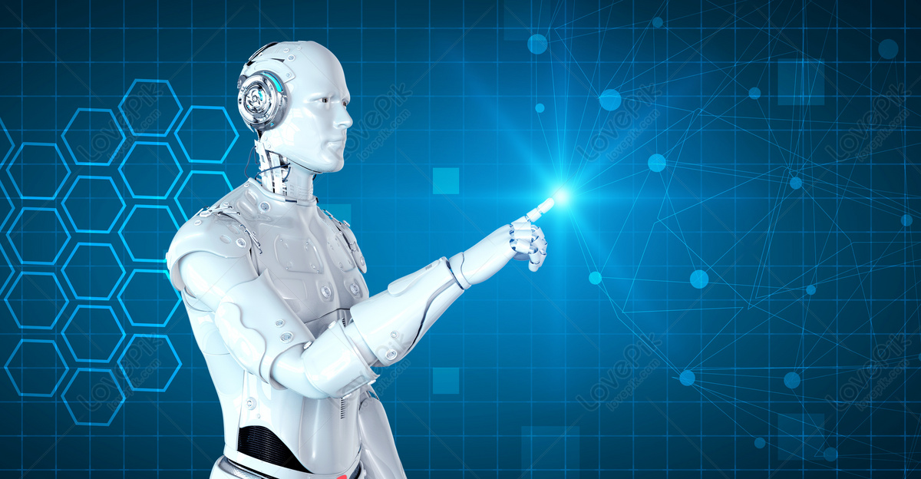
Student’s articles
ROBOTICS TECHNOLOGY
Robotics is an interdisciplinary field that combines computer science, engineering, and mathematics to create, design, and develop intelligent machines called robots. These robots are capable of performing a wide range of tasks autonomously or with minimal human intervention.
The primary objective of robotics is to design and build machines that can substitute humans in executing dangerous, repetitive, or tedious tasks, thereby improving efficiency and productivity. Robots can be found in many industries, including manufacturing, healthcare, agriculture, defense, and space exploration.
Robotics involves various branches and subfields, such as autonomous systems, artificial intelligence, machine learning, computer vision, mechatronics, and human-robot interaction. These disciplines contribute to the creation of robots with advanced capabilities like perception, decision-making, learning, and communication.
There are different types of robots, such as industrial robots used in manufacturing processes, service robots employed in hospitality and healthcare industries, and exploration robots used in space missions and underwater exploration. These robots can have different forms, ranging from humanoid robots that resemble humans to drones and robotic arms.
Advances in robotics have led to significant advancements in various sectors. In manufacturing, robots have revolutionized production lines, increasing precision, speed, and efficiency. In healthcare, surgical robots enable doctors to perform complex procedures with enhanced precision and reduced invasiveness. Moreover, robots are used in disaster response scenarios, environmental research, and even in the entertainment industry.
However, robotics also poses challenges and ethical considerations. As robots become more intelligent, there are concerns about job displacement and the impact on society. There is also ongoing debate regarding the development of autonomous weapons and the ethical implications of using robots in warfare.
Overall, robotics continues to evolve rapidly, pushing the boundaries of technological innovation. With ongoing research and development, robotics holds great promise for shaping the future by offering solutions to various global challenges and improving the quality of human life.
VARIOUS Applications of robotics · Manufacturing automation · Healthcare · Space Missions · Logistics · Education · Entertainment · Environmental monitoring.
GOVERNMENT POLYTECHNIC FOR WOMEN, KADAPA

Slide 13
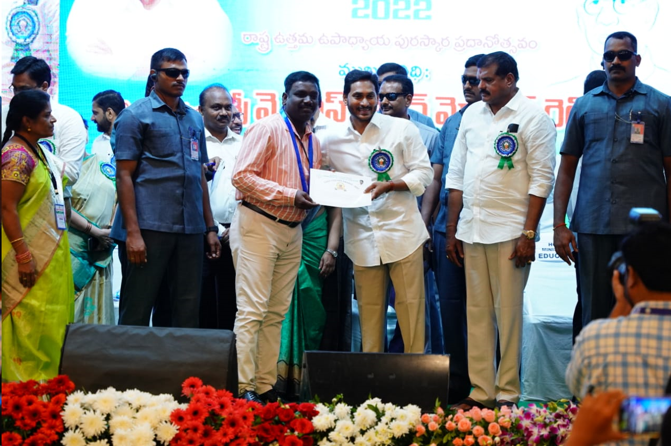
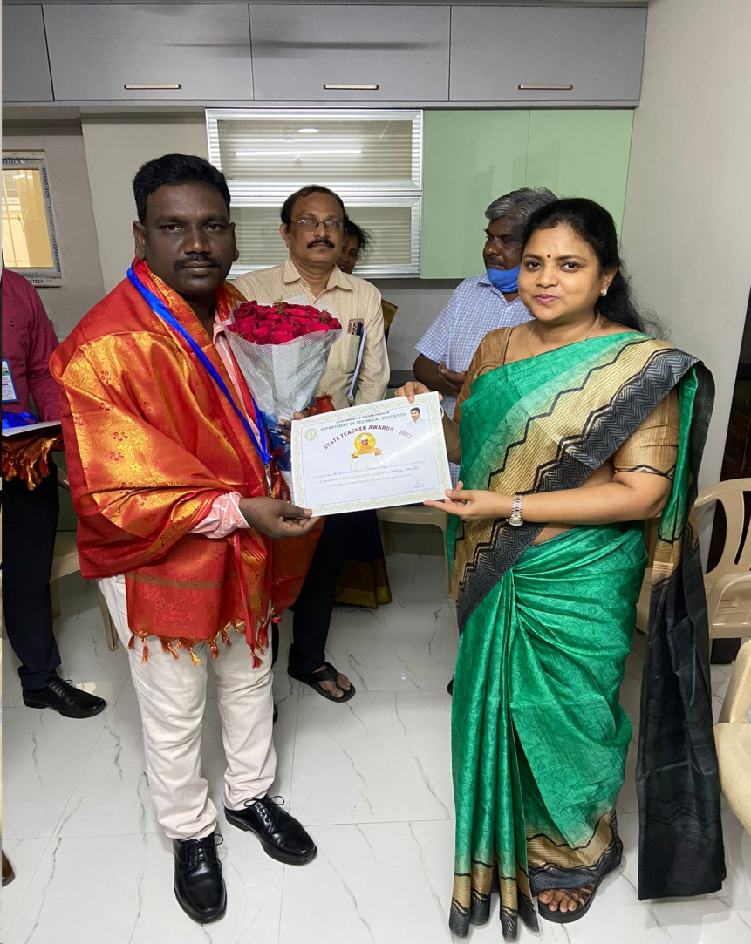
DR.V.HARI PRASAD Receiving the Best State Teacher Award of 2022-23 from our Honourable Chief Minister Sri. Y.S.Jagan Mohan Reddy Garu and our Technical Education Department Commisioner Smt. C.Naga Rani Garu I.A.S
DEPARTMENT ACHIEVEMENTS
GOVERNMENT POLYTECHNIC FOR WOMEN, KADAPA
Notes:
DR.V.HARI PRASAD Receiving the Best State Teacher Award of 2022-23 from our Honourable Chief Minister Sri. Y.S.Jagan Mohan Reddy Garu and our Department Commisioner Smt. C.Naga Rani Garu I.A.S

Slide 14
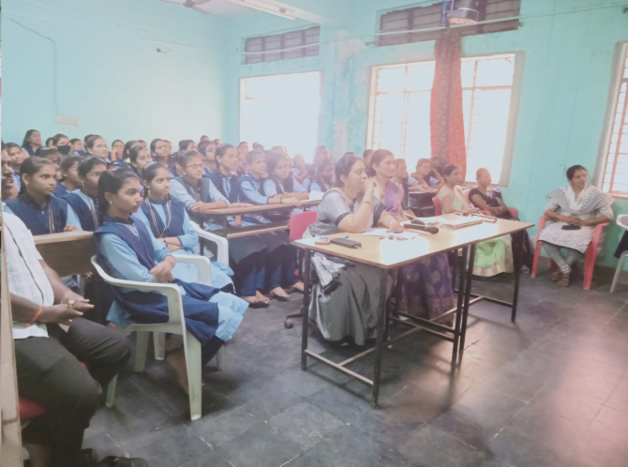
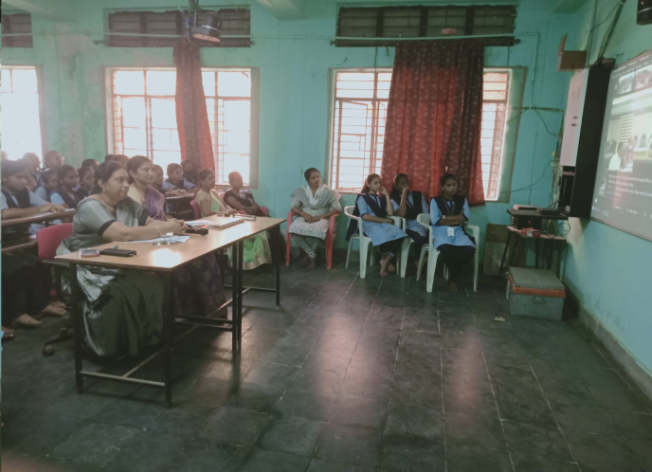
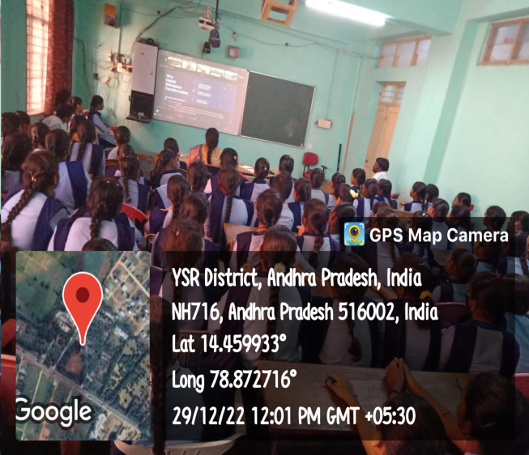
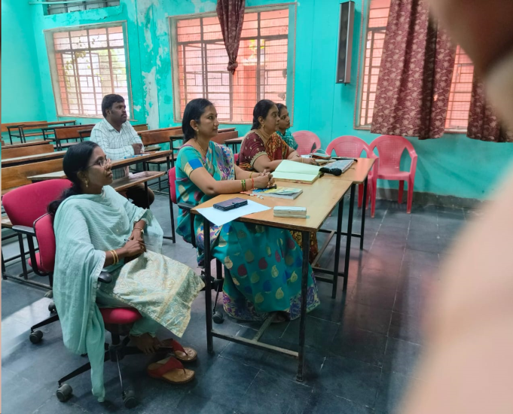
ACTIVITIES IN DEPARTMEnt WEBINAR
GOVERNMENT POLYTECHNIC FOR WOMEN, KADAPA

Slide 15
CROSS WORD
1
On the Computer
2
4
3
5
6
WORDS DOWN
1. Use google to search it
2.Shows the picture
3.Comes use toner
5. Connect accessories to computers
WORDS ACROSS
4.Not for typing
6.For typing

Slide 16
THANK YOU!

